Slide 1




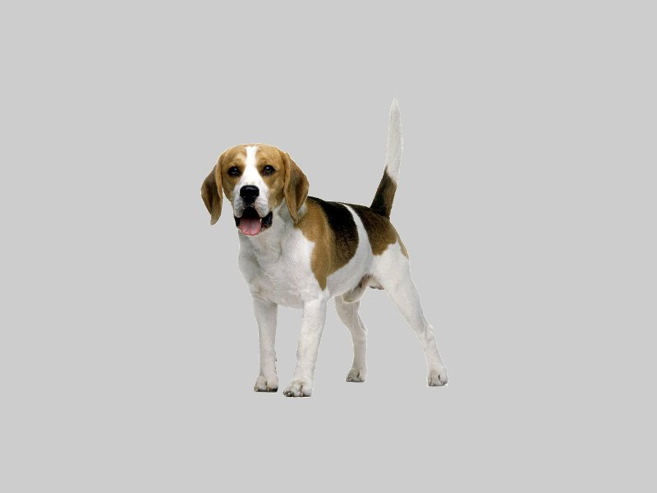
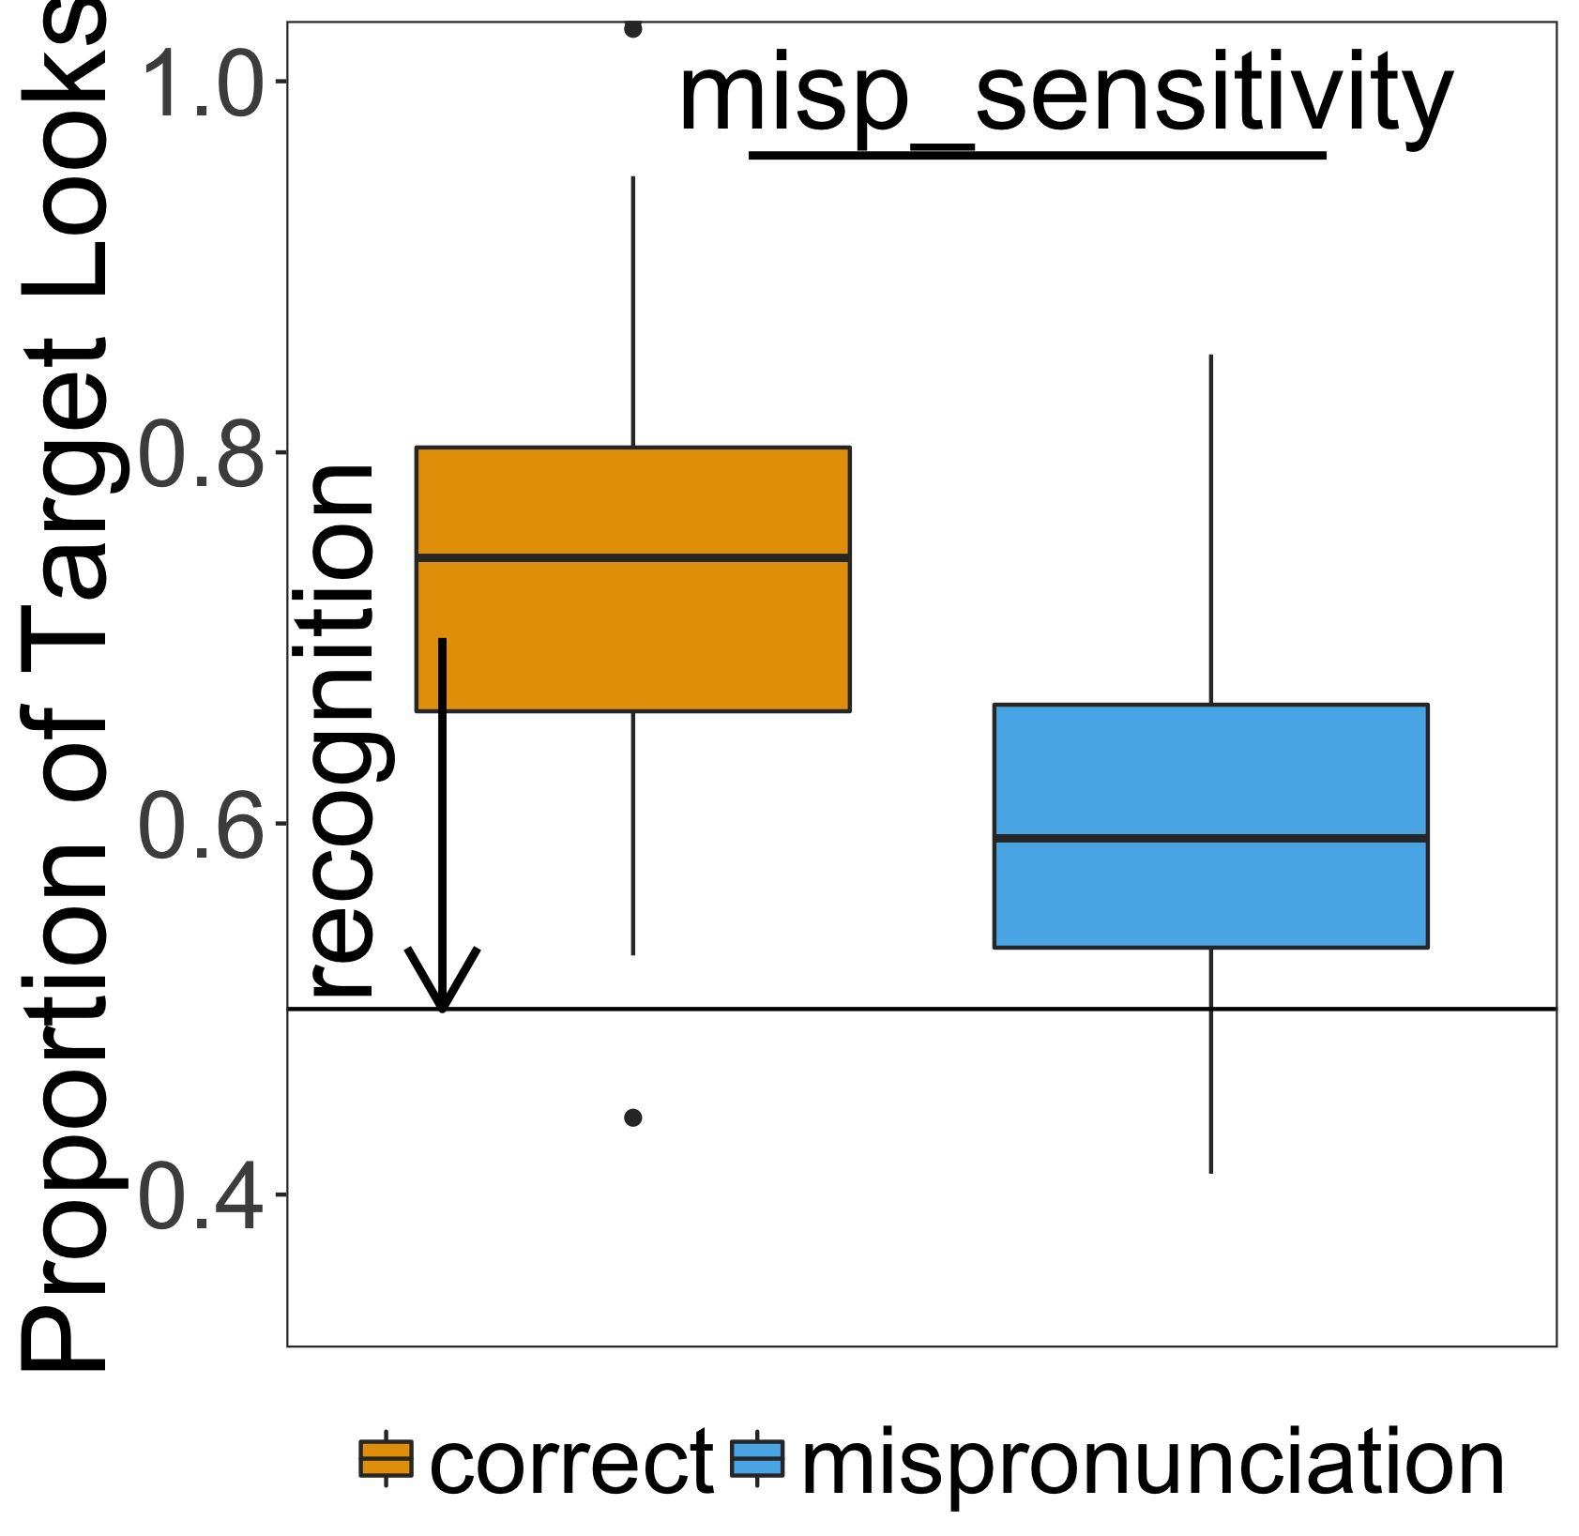
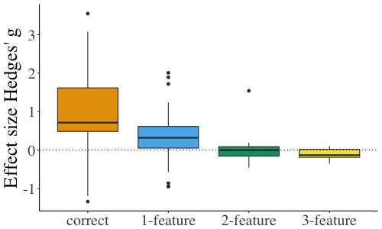
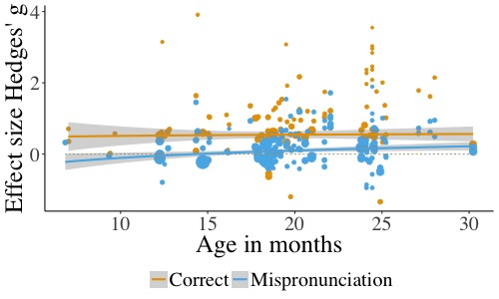
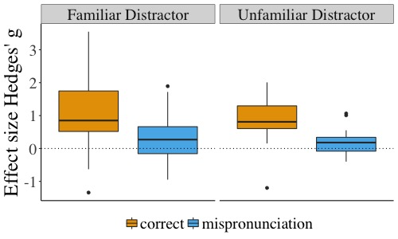


A meta-analysis of mispronunciation sensitivity in infancy
Katie Von Holzen^{1,2} & Christina Bergmann^{3,4}
1. University of Maryland, USA
2. Université Paris Rene Descartes, Laboratoire de Psychologie de la Perception CNRS, France
3. Max Planck Institute for Psycholinguistics, The Netherlands
4. LSCP, Département d'Etudes Cognitives, ENS, EHESS, CNRS, PSL Research University
Mispronunciation Sensitivity
Infants’ sensitivity to changes in the phonological form of familiar words
Database Information
32 papers (27 journal articles)
249 unique experimental conditions
2252 infants
6 to 31 months-of-age
Participants | Stimuli | Procedure | Results
Age in days | # features | # trials | DV type
Sample size (n) | Change position | Distractor familiarity/overlap | vocabulary
Native Language | Consonant/vowel |  | misp sensitivity
Dog
Tog
Does the number of phonological features changed modulate mispronunciation sensitivity?
How does mispronunciation sensitivity change as infants develop?
More sensitive with development¹
Less sensitive with development²
No change in sensitivity with development
Correct
Recognition: g = 0.91, SE = 0.12, p < .0001
Mispronunciation
Recognition: g = 0.25, SE = 0.06, p < .0001
Correct vs. Mispronunciation
Sensitivity: g = .5, SE = .03, p < .0001
Interactions with Age
No significant interactions with Age
Features
Number: g = -0.31, SE = 0.03, p < .0001
Interactions with Age
No significant interactions with Age
*Focus on ages 18 to 30 months where feature is manipulated*
Does familiarity with the distractor image modulate mispronunciation sensitivity?
Distractor Familiarity
Sensitivity: g = 0.19, SE = 0.09, p < .05
Interactions with Age
No significant interactions with age
*Focus on ages 18 to 25 months where familiar & unfamiliar distractors used
Conclusions
Sensitivity to mispronunciations stays consistent as infants age (Theory 3)
Sensitivity to mispronunciations increases as the number of features changed increases; consistent as infants age
Infants are sensitive to size of mispronunciation^{3,4}
Mispronunciation sensitivity greater with unfamiliar distractor; consistent as infants age
Unfamiliar object is a more viable option for mispronunciation than known familiar object⁵
What’s in your File Drawer?
Do you have a mispronunciation study that is unpublished?
Contact us and add it to our meta-analysis!
References
Werker & Curtin (2005). PRIMIR: A Developmental Framework of Infant Speech Processing. Lang Learn and Dev
Best (1994). The emergence of native-language phonological influences in infants: A perceptual assimilation model. Haskins Laboratories Status Report on Speech Research
White & Morgan (2008). Sub-segmental detail in early lexical representations. Journal of Memory and Cognition
Mani & Plunkett (2011). Does size matter? Subsegmental cues to vowel mispronunciation detection. J of Child Lang
Halberda (2003). The development of a word-learning strategy. Cognition
Contact: Katie Von Holzen (katie.m.vonholzen@gmail.com) & Christina Bergmann (chbergma@gmail.com)

